Slide 1
Two-Tiered City Logistics
Modelling Demand Uncertainty in Tactical Planning
Teodor Gabriel Crainic
TeodorGabriel.Crainic@CIRRELT.ca
Colloque Logistique Urbaine et Interdisciplinarité, Paris
Le 27 novembre 2014

Slide 2
City Logistics Ideas
“New” organizational strategies/models
  Reduce & control freight vehicle flows & types
  Improve efficiency of freight transportation
    Higher loads, less empty vehicle-km
  Reduce environmental footprint & congestion & interference with people impact
Without penalizing its economic activities
To foster an efficient transportation system
To make the city a better place to experience: live, work, visit, move within and through …
Work on demand & supply sides + behaviour, policy, regulation, law, …

Slide 3
Move Freight Differently, “Out of the Way”
Underground automated systems: new supply systems
  Conveyor belts or adapted vehicles on particular infrastructure
  Particular packing
  Loading/unloading stations
  Huge investments required
Night deliveries: Move the demand out in time
  Successful pilot in New York city – much interest elsewhere
  Requires particular city regulations
  Does not necessarily decrease number of vehicles

Slide 4
Move Freight Differently (2)
Most actual systems, past projects and proposals are based somehow on the principle of
Consolidation and coordination
  Coordination of shippers and carriers (& consignees)
  Consolidation of several shipments of different shippers & carriers into, and delivery by the same (improved, more energy efficient, “green”) vehicle
Makes use of one or a series of terminals
  Consolidation facilities, Urban / city distribution / logistics centers, of various sizes and roles

Slide 5
The City Logistics (Supply) Fundamental Idea
An integrated logistics system =
  Shippers, shipments
  Carriers (all modes including passenger and interurban, e.g., rail, navigation), vehicles
  Service providers, consignees/customers, …
Optimize this logistics system
“Public system” view (not ownership!) operated as best fits the local culture, laws and regulations

Slide 6
Single-Tier Single-CDC City Logistics
City
Distribution
Center
Customer
zone
Urban vehicle

Slide 7
City Logistics for Large or Sensitive Urban Areas
Most display a two-tier structure
  Loads consolidated at CDC into “large” vehicles
  Moved to CDC-like facilities – satellites – “close” to customers
  Transferred to “small” vehicles appropriate for city center
  Delivered to final destinations

Slide 8
Multi-Tiered City Logistics
Origin-node
P
Satellites
S
S
S
P
Center 2
Platforms
Center 1
Navigation Terminals
S
Railway station
Depots
S
S
S
P
Airport
Railway station

Slide 9
Two-Tier City Logistics
CDC
Satellite CDC

Slide 10
Two-Tier City Logistics
City freighter - route
Urban vehicle - route
Empty vehicle

Slide 11
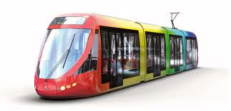
2T-CL with Rail & Transit (Public Transport)
Navigation
City Freighter
Urban Vehicle
Long-Haul Trucks
Rail
Satellite Crossdock
Customer
Distribution center
City Distribution Center
City route

Slide 12
City Logistics for Large Cities
Several not necessarily integrated sub-systems
Many have access to some public infrastructure (light rail lines, parking lots, …) even for private initiatives
A few initiatives to use dynamically available transportation & storage capacity
An implicit idea: Disconnect the actual mean of transportation / delivery from the carrier/shipper/3PL originally contracted
Private inititive implementing CL operating principles
Multimodal systems that aim for intermodality

Slide 13
Modular & Standard Physical Internet π-Containers

Slide 14
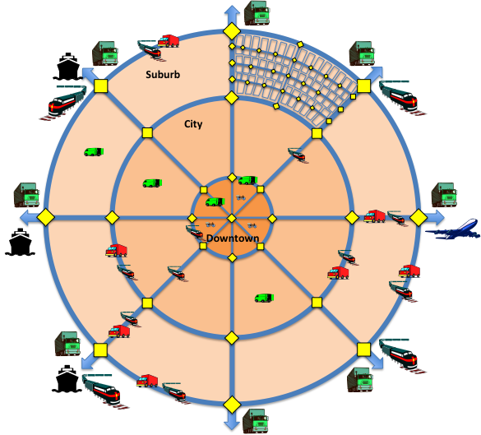
Interconnected, Multi-tiered City Logistics
Plane
Urban vehicle
Ship
City freighter
Train
Long-distance
vehicle
Bicycle
Urban hub

Slide 15
Challenges & Opportunities
CL = complex consolidation-based transport system
  Multiple “layers”, facilities, fleets, modes
  Time restrictions, dependencies, synchronization
Goal of sustainable efficiency for stakeholders & city
  Operations Research & Transportation Science
  “New” problems ⇒ New models, algorithms, instruments
  Methods for the system and its components
    Appropriate for the decision-level concerned

Slide 16
Challenges & Opportunities (2)
Culturally and socially-aware organization and business models, e.g.,
Cultural (government ↔ people & business, business models, taxation, etc.) impact and need for somewhat tailored solutions
Stakeholder behaviour modelling
Demand identification and modelling
Partnerships & collaborations → Supply modelling
Public policy
Materials (“boxes”), law, regulation, land use, …

Slide 17
An illustration of O.R. development:
Uncertainty and tactical planning
Nicoletta Ricciardi (Sapienza U. di Roma)
Walter Rei (UQAM)
Fausto Errico (CIRRELT)

Slide 18
Tactical (Medium-term) Planning
season
X
Build
the plan
day
X
Adjust the plan
Tactical planning = Plan regular operations, based on a (point) forecast, for efficient resource allocation & utilization, customer satisfaction, profitable operations
Day-to-day situation generally different from forecast

Slide 19
Accounting for Uncertainty
System data
Forecast demand
season
X
Build a more flexible and robust plan
day
X
Adjust the plan “less”
Observed demand
Tactical medium-term planning accounting for uncertainty = Integrate into the tactical planning model/method the possible “adjustments” and their costs

Slide 20
Sources of Uncertainty in City Logistics
Time
  Work at facilities & service at customers
  Travel through the city
Demand (regularity of activities within customer zones)
  Volume (including no show; volume = 0)
  Unexpected
Rare but predictable events (e.g., vehicle or infrastructure incidents)
Rare, “catastrophic” events

Slide 21
Demand Uncertainty & Planning
Robust plans (flexible operations) versus managerial concerns
Build a season plan based on available/forecast data
Each “day”, once the uncertain demand data is resolved
  Keep part/most of the plan
    External and satellite facility utilization
    Urban-vehicle service network
  Adjust using a recourse policy
    Routing city freighters and extra vehicles
Two-stage modelling

Slide 22
Two-Stage Modelling Framework
Two-stage recourse formulation
First stage
  Selection of first-tier services (& departure times)
  Allocation of customers to services & satellites
Second stage
  Routing of second-tier city freighters
  Service adjustment (eventually)
  Customer-to-satellite allocation (eventually)
  Calling on extra vehicles (when required)

Slide 23
Two-Stage Stochastic Programming
A priori optimization
First-stage decisions: the a priori plan x
: Realization of demand for
: Cost of “optimal” operation plan using the a priori plan for demand given a recourse policy RP

Slide 24
Problem Elements: Facilities & Customers
External zone
e
Satellite
d
Customer demand

Slide 25
Scheduled Urban-Vehicle Services
Decision: Which
service to run?
(When?)
ρ(r) ∈ {1,0}
s
r: t(r)=t+1
r’: t(r’)=t
r’: t(r’)=t; σ(r)={z}
e

Slide 26
City-Freighter Work Segment & Assignment
e’t’
e’’t’’
e’’’t’’’
c₂
c₃
c₄
c₁
c₅
c₆
c₇
c₈
st
Decision: Which
c-f work assignment
to operate?
c₁
s’t⁺
c₃
ϕ(h) ∈{1,0}
c₂
c₈
c₆
c₄
c₇
gt⁻
c₅
g’t⁺⁺

Slide 27
Demand Itineraries
Select itinerary to deliver cargo on time:
ζ(m) ∈ {1,0}
z’
d
z
m:{e,r(m),t(m) < t(r),
z(m)=z(m)∈ σ(r(m)),
ν(p(d)), l(h(m)), c(d)}
d: e,c,p,t,[a,b],vol
e

Slide 28
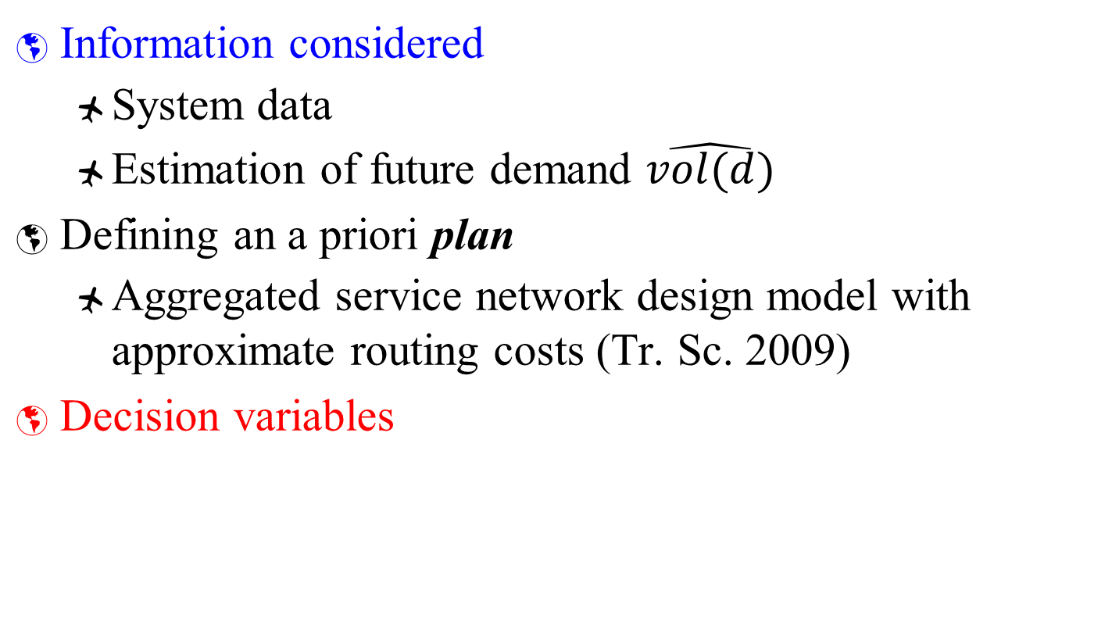
First Stage
Information considered
  System data
  Estimation of future demand $\hat{vol(d)}$
Defining an a priori plan
  Aggregated service network design model with approximate routing costs (Tr. Sc. 2009)
Decision variables

Slide 29
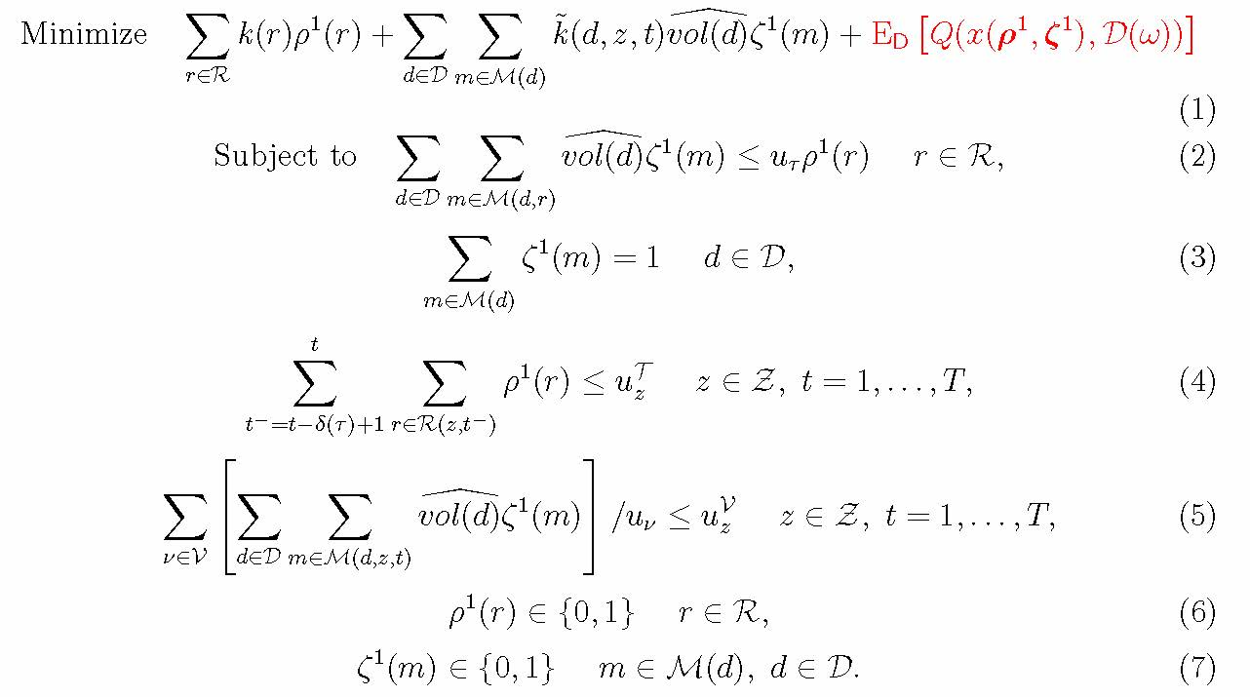
First Stage Formulation
Generalized cost
first-tier services
Generalized cost second-tier
work assignments – forecast demand
Recourse cost
U. Vehicle capacity
Linking
Single itinerary
Satellite capacity
U. Vehicles
C. Freighters

Slide 30
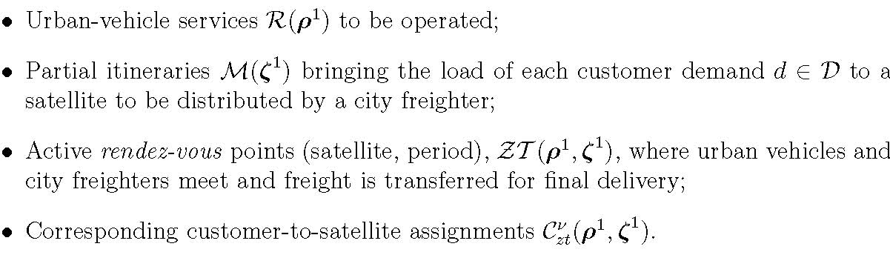
First Stage Output – The Plan

Slide 31
Second Stage – Observing the Demand
All demands ≤ Forecasts
  Determine routing =
  Synchronized, scheduled, multi-depot, multiple-tour, heterogeneous VRPTW
  Attempt to improve system response =
  Apply a recourse policy + routing
Adjust plan + routing, otherwise
Straightforward to determine which customers need extra capacity to be serviced

Slide 32
2nd Stage Recourse Policies
Routing (R)
Routing & possible customer re-assignment (RA)
Service Dispatch and Routing (SR)
Service Dispatch, Routing & possible customer re-assignment (SRA)
Increased latitude in the recourse actions
Extra city freighters with high cost for the demand that cannot be moved by regular vehicles
  A single city-freighter fleet to service the “regular” and the “extra” demand
  Direct-shipment policy

Slide 33
3-Leg City Freighter Work Segment
Direct shipment

Slide 34
2nd Stage Routing Recourse
Keep
  Selected first-tier services (routes and schedules)
  Customer-to-satellite assignments → Bounds on second-tier vehicle departures at each rendez-vous point (satellite, period)
Optimize the routing & demand itineraries

Slide 35
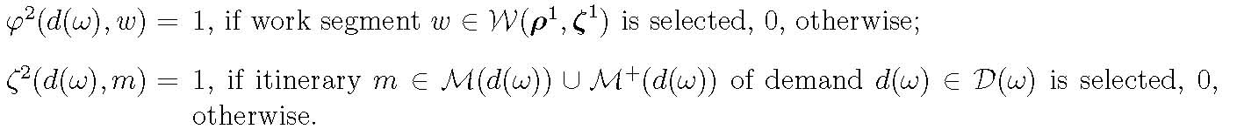
2nd Stage Routing Recourse
Keep
  Selected first-tier services (routes and schedules)
  Customer-to-satellite assignments → Bounds on second-tier vehicle departures at each rendez-vous point (satellite, period)
Optimize the routing & demand itineraries

Slide 36
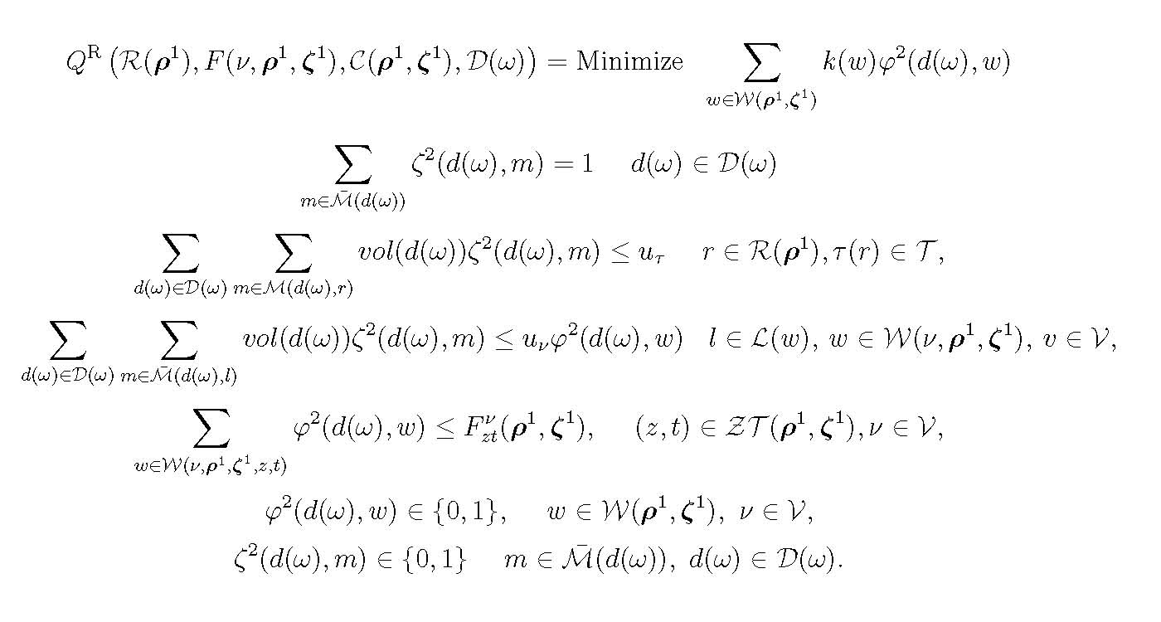
Formulation

Slide 37
2nd Stage Route & Reassign Recourse
Keep
  Selected first-tier services (routes and schedules)
Relax the customer-to-satellite rendez-vous assignments
Optimize the routing & demand itineraries without pre-assignment of customers to satellites
Same formulation, larger set of itineraries, simpler stochastic formulation

Slide 38
2nd Stage Service Dispatch and Routing Recourse
Keep
  Selected first-tier services (routes and schedules)
  Customer demands to be served from each (satellite, period) point
Identify satellite opportunity windows and urban-vehicle compatible services

Slide 39
Output of Service Network Design
et’
zt
i
j
k

Slide 40
Opportunity Windows and Compatible Services
et’
zt
i
j
k

Slide 41
2nd Stage Service Dispatch and Routing Recourse
Optimize the restricted selection of services, the routing of regular and extra city freighters & demand itineraries: restricted tactical model
  With and without fixed customer-to-rendez-point assignment

Slide 42
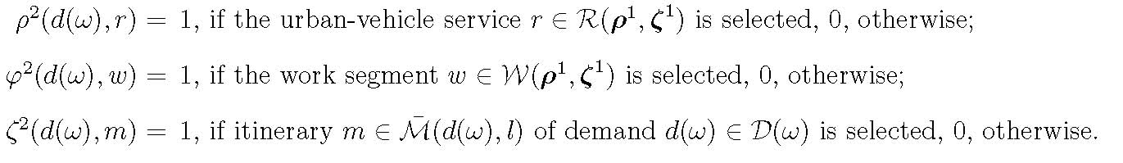
2nd Stage Service Dispatch and Routing Recourse
Optimize the restricted selection of services, the routing of regular and extra city freighters & demand itineraries: restricted tactical model
With and without fixed customer-to-rendez-point assignment

Slide 43
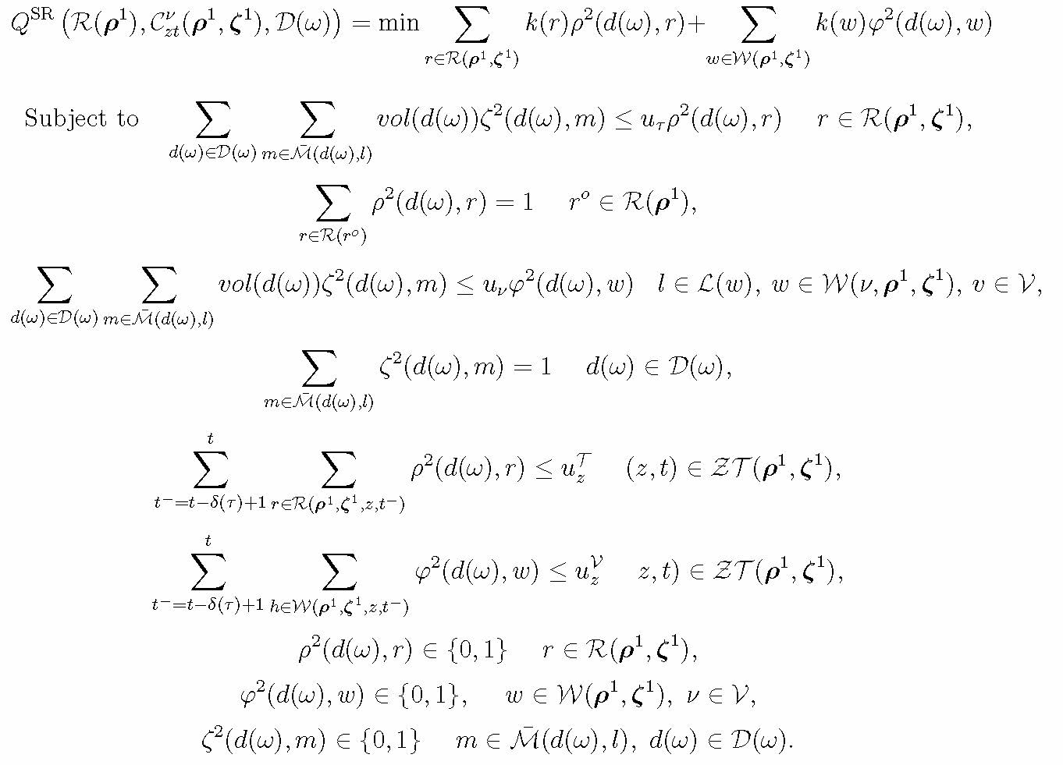
Formulation SR Recourse

Slide 44
Experimental Study of Recourse Alternatives
System performance & management issues
Monte Carlo-like simulation
  Not an evaluation of the value of stochastic model

Slide 45
Experimental Setup
The four recourse strategies
No tactical plan but daily plan = “the day before”
A simplified setting: single product & vehicle type, fixed travel times, no split
Data sets randomly generated – “small” dimensions
(including with realistic geographical settings)
  1-2 external zones, 2-3 satellites, 15 & 25 customer zones, 6 periods of 25 minutes (2.5 hours)
  2 demand-size distributions, 2 prediction values

Slide 46
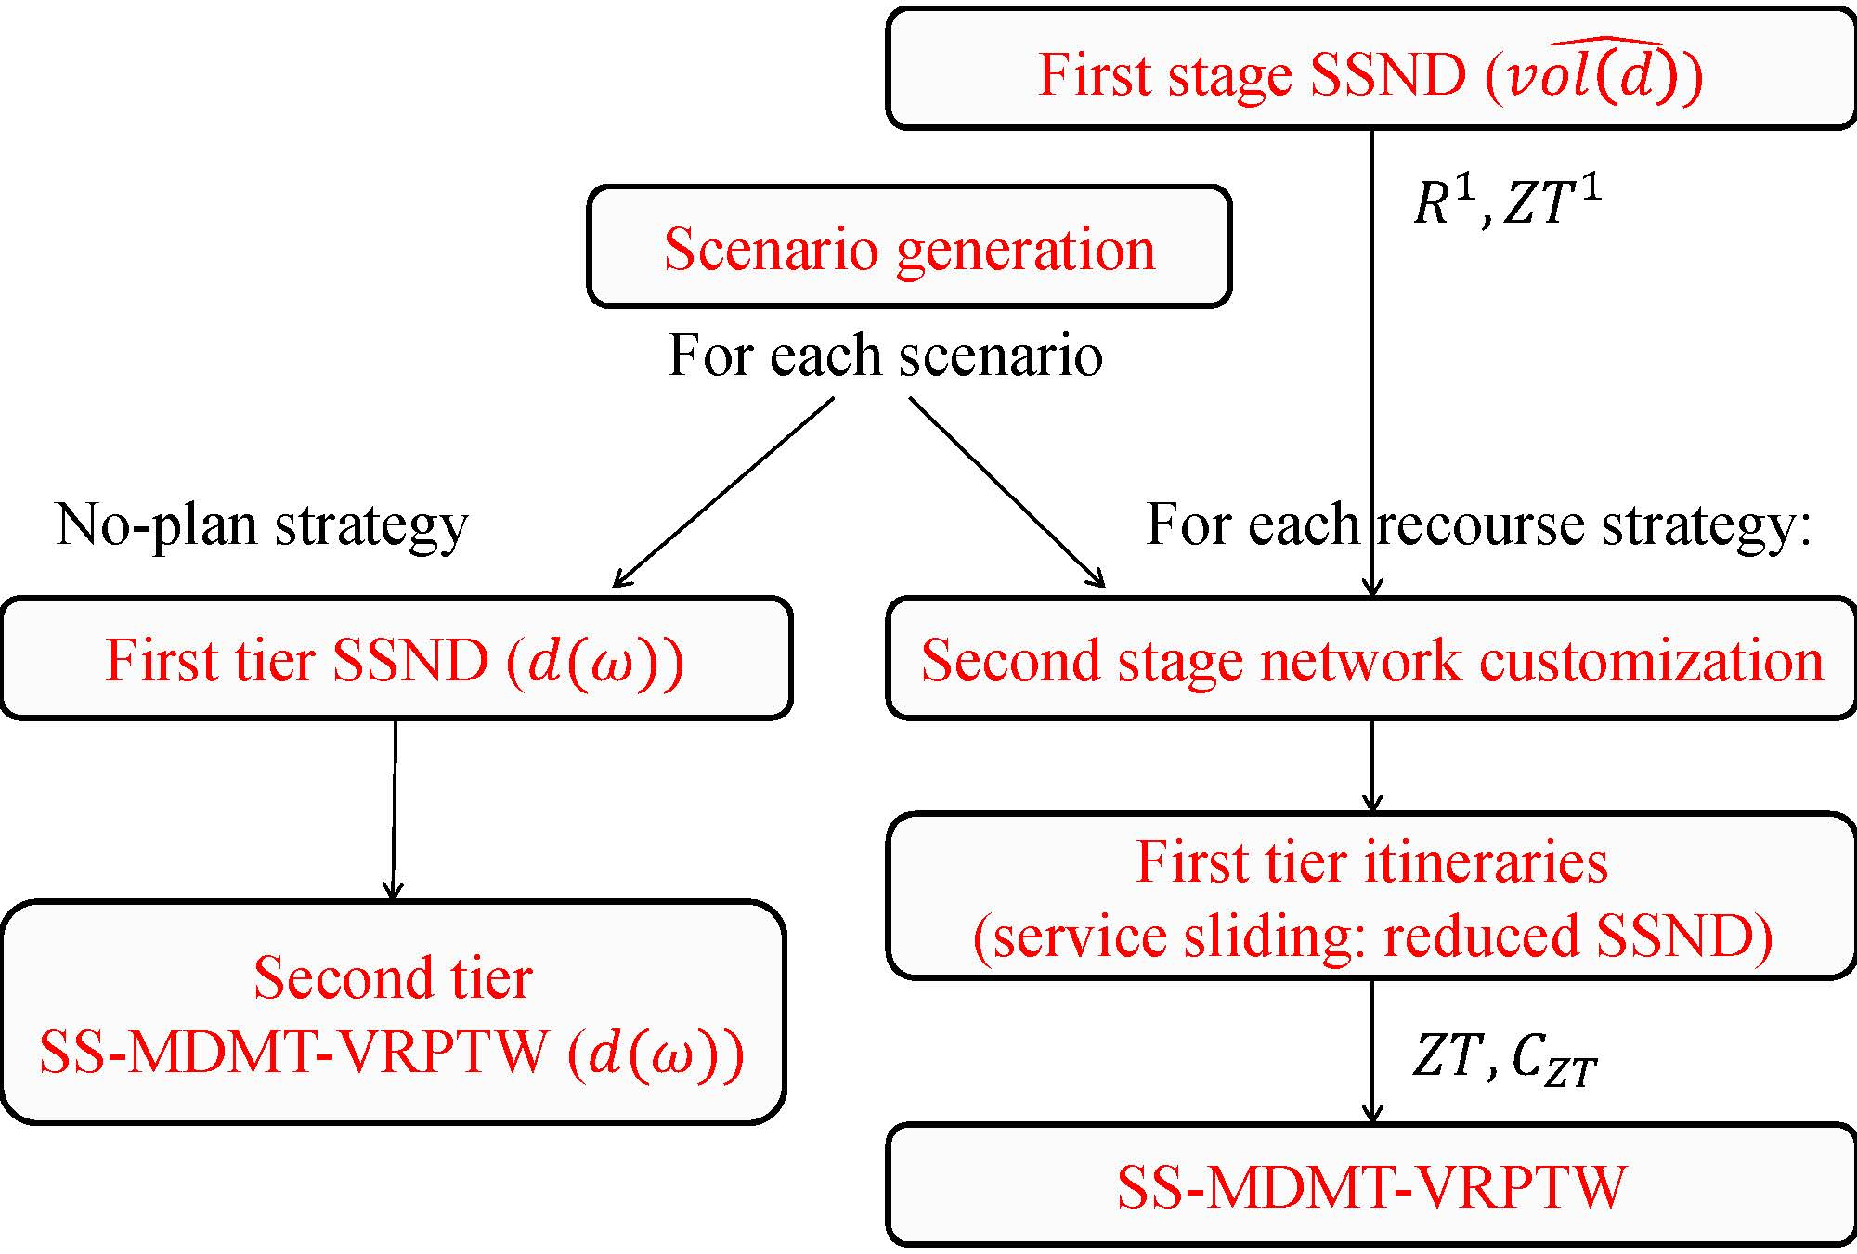
Evaluation Procedure

Slide 47
The Hierarchical Decomposition
Customer-to-satellite assignment
Approximate cost of serving each customer from its satellite
Urban-vehicle service design
Selected services
Custer demands at satellite-period
City-Freighter routing
City-freighter work assignments

Slide 48
Experimental Setup (2)
Analyses based on
  Traffic intensity: numbers of vehicles, vehicle-km
  Vehicle (capacity) utilization
  System cost
  Impact & social cost
  Managerial concerns

Slide 49
Cost Analysis
No-planning = Lower bound on costs & no direct deliveries (extra vehicles); Management (e.g., labor)?
Cost of planning ≈15% and but extra vehicles
More flexibility = less direct services (60%, lower variance) & costs (2% - 3.5%)
Direct services: ↑nb. Customers, ↓nb. of CDC
Do not use the “average” forecast

Slide 50
Route Length Analysis
More flexibility = shorter city-freighter routes (4,8%) and less empty travel (6%)
Higher empty travel with # of customers
Lower empty travel with # of external zones / satellites
Modifying – sliding – the urban-vehicle departures appears beneficial

Slide 51
Vehicle Capacity Utilization
No planning = few more vehicles 1st level, less on 2nd
Planning yields very good loading factors
More flexibility yields better vehicle loadings (≈ 15%)
Most city freighters operate a single leg, a few two ⇒ Need to investigate “waiting” strategies (synchronization is hard)

Slide 52
Satellite Utilization
Standard deviations
System appears stable
Increasing flexibility, increases the “volatility” of using the satellites
Trade off to find between operation flexibility and management concerns
Need of ITS

Slide 53
Conclusions and Perspectives
Flexibility in adjusting the plan is beneficial on all counts: costs, km performed, capacity utilization …
It might come with higher requirements for management (& labor relations and work rules) flexibility
Needs advanced IT and decision-support systems
NOW:
Address the stochastic models (and the deterministic ;-)
Large dimensions
City Logistics systems design, policies, financing, …

Slide 54
