Slide 1
Extraits de http://hallofshame.gp.co.at/
Erreurs de design de professionnels

Slide 2
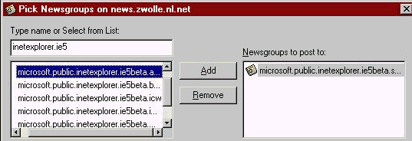
Un dialog de Outlook Express Newsreader de Microsoft
Notes:
Ici, il n’y a pas assez d’espace dans la fenêtre pour voir les noms complets et visiblement, la scrollbar ne permet pas de résoudre le problème. Cette boîte de dialogue n’étant pas agrandissable, l’utilisateur n’a aucun moyen de résoudre le problème…
The dialog is presented when the user wants to send a message to more than one newsgroup. There is one not insubstantial problem, however, there is not enough space in the windows to show the full names of the newsgroups! A horizontal scrollbar is provided, but as is evident in the image, the scrollbar is useless. And, in typical Microsoft design style, the dialog is not resizable. The designer screwed up, the quality assurance department screwed up, and apparently, Microsoft's usability testing division screwed up by not finding such an obvious fault.

Slide 3
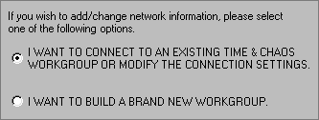
Time & Chaos
Notes:
Ces options de Time & Chaos doivent être bien importantes pour avoir été ainsi écrites en majuscules !
Evitez les majuscules est une des premières règles de politesse. De surcroît, l’utilisation de majuscules rend le message difficile à lire.
Some of the network options in Time & Chaos must be REALLY IMPORTANT. Why else would the developers have displayed them in all uppercase?
Avoiding uppercase is one of the first rules of netiquette because it is universally interpreted as shouting, and immediately indicates that the writer is either a pyramid marketer ("GET RICH REALLY QUICK!"), or a first-time user ("HOW DO I SEND A MESSAGE").
In perceptual terms, the use of all uppercase makes the information inherently difficult to read. DON'T USE IT.

Slide 4
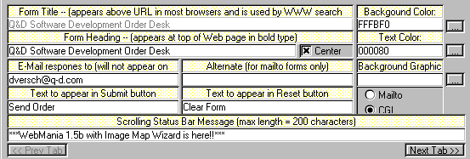
Webforms
Notes:
Cet écran très merdique choque les yeux. Les labels ne sont pas alignés avec les champs auxquels ils sont associés, ce qui oblige à zigzaguer…
Le choix de couleurs pour distinguer les labels des champs éditables rajoute de la confusion. En outre, placer l’information d’aide dans les labels rajoute encore de la confusion. La case à cocher n’a l’air reliée à rien …
This image, from Webforms, simply hurts the eyes. Labels are not aligned to the fields they are associated with, causing the eyes to zig-zag around the screen as the user attempts to locate a field of interest. The choice of color to distinguish labels from editable fields further adds to the headache. Further, placing help information (will not appear on...WHAT?) in the labels just adds to the mess. Given that their status bar is too difficult to read, they probably decided that this was probably the next best place for it.

Slide 5
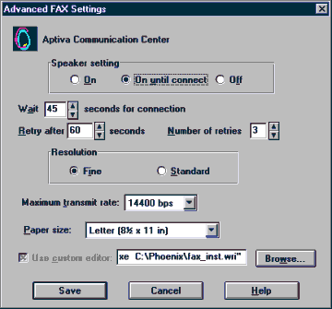
from IBM's Aptiva Communication Center
Notes:
Ici, on voit que les développeurs voulaient voir les affectations de paramètres à l’écran plutôt que de faciliter leurs entrées à l’utilisateur…Il n’y a pas de lecture simple de cet écran, vos yeux se baladent anarchiquement en essayant de mettre de l’ordre. Une bonne manière de procédéder serait d’organiser le flot d’information par des regroupements spaciaux afon de faciliter la localisation d’une onformation spécifique recherchée… On remarquera en particulier qu’ini il n’y a pas de zone délimitée, ni de cadre, ni de titre.
If you really want to make things difficult for your users, just slap a screen together without regard for order or organization. This image is taken from IBM's Aptiva Communication Center, and demonstrates to us at least, that the developers simply wanted to get the settings on the screen, rather than make it easy for people to adjust the settings. There is no flow to the screen; your eyes just jump around from place to place as your brain tries to elicit some sort of order.
A well-designed screen, in stark contrast to this image, uses position, alignment, and grouping to organize the information, to provide an information flow. This not only makes it easier to locate a specific piece of information, it relieves the brain from having to subconsciously apply order.

Slide 6
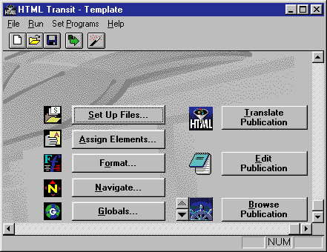
HTML Transit
Notes:
HTML transit est une application très utilisée qui permet de convertir divers formats de fichiers en HTML. L’interface semble agréable à première vue, mais malheureusement cela ne signifie pas qu’elle soit « utilisable ». Un aspect problématique est que cet écran se présente comme celui d’une fenêtre principale d’application (menu File, etc.) avec paradoxalement aussi des éléments de boîtes de dialogue comme les boutons de commande. Si l’on utilise le Opendu File menu, cela ne fait que changer le titre de la fenêtre, et le New ne fait rien ! Dans les deux cas, le contenu de la fenêtre ne change pas (contrairement à ce qui se passe dans une apllication). Un utilisateur non averti risque de faire New plusieurs fois de suite, et conclura que le programme ne marche pas. Le problème de base est que ce programme ne procure aucun feed-back sur l’opération effectuée. L’utilisateur doit cliquer sur les boutons de commande de la colonne de gauche pour voir l’information associée. Cliquer sur n’importe quel bouton de la colonne de droite génèrera un message d’erreur sauf si l’utilisateur a spécifié des paramètres ailleurs dans le programme. C’est une structure complètement anarchique qui a du faire que ce logiciel, pourtant utile, n’aura pas eu beaucoup d’adeptes…
HTML Transit is an award-winning, very useful application that converts a number of file formats to HTML for use in web sites. When first loaded, it presents a visually pleasing interface. Unfortunately, "useful" and "visually pleasing" do not necessarily translate to "usable".
One problematic aspect of the program is that it gives the appearance of a multiple-document interface (MDI) application, as indicated by the File menu, but also acts as a dialog box, as indicated by the command buttons on the main window. In all other MDI applications, when the user has selected "New" or "Open" from the File menu, the contents of the window will display the contents of the file. In HTML Transit however, selecting "Open" only gives the appearance of changing the title of the window, and selecting "New" does ... nothing. In either case, the contents of the main window does not change. The new user is likely to select "New" several times, then, after concluding that the program does not work, uninstall the program.
The basic problem with the program is that it does not provide visual feedback that the operation was successful. The user must open one of the various dialog boxes associated with the command buttons (in the left column) to see the information associated with the template. Clicking any of the buttons in the right column will generate an error message unless the user has specified settings elsewhere in the program. This is an entirely confusing structure that is likely to cause InfoAccess to lose quite a few potential customers.

Slide 7
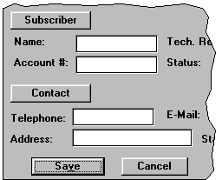
Notes:
Sur cette fenêtre, les développeurs ont choisi de donner aux labels des sections une apparence surélevée. C’est une des manières d’assurer que l’utilisateur ne les confonde pas avec des champs éditables certes, mais par contre, il ne sera pas surprenant qu’il veuille cliquer dessus !
In this image, the developer has chosen to give the section labels a raised appearance. That's one way of ensuring that the user doesn't confuse them with the editable fields, but does it come as any surprise that users try to click on them?

Slide 8
WebForms
Notes:
C’est une image de la barre de statut utilisée dans Webforms. Une barre de statut est censée fournir une information descriptive permettant d’aider l’utilisateur à apprendre à utiliser l’application. Malheureusement le choix ici de la couleur rouge sur fond gris, et de la 3D rend cette information quasiment impossible à lire.
This is an image of the status bar used in Webforms, developed by Q&D Software Development. It is intended to provide descriptive information that helps users learn how to use the application. Unfortunately, the choice of color and the use of a 3-D font make the information almost impossible to read. By the way, we're pretty sure that the text reads: "HTML Browse" or "HTML/Browse". "Preview" would have been a better choice, but since you can't read it anyhow, it hardly matters.

Slide 9
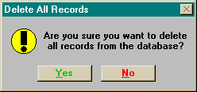
Notes:
L’enfer est pavé de bonnes intentions. Ici, cette boîte provient d’une application où les couleurs du texte des boutons de commandes étaient toujours d’avoir le vert pour les affirmations (Yes, OK, Open) et le rouge pour les négations (Cancel, Close, No). Malheureusement, cette manière systématique pose un certain nombre de problèmes. Tout d’abord, celui du contraste avec la couleur du bouton qui provient elle des préférences Windows. En outre, ce choix peut être inconsistant avec certaines taches. En occident, le vert peut être associé avec le « bon » choix. Mais comme ici sur cet exemple, détruire tous les enregistrements n’ets certainement pas la bonne chose à faire. En troisième lieu, le choix des couleurs n’est pas toujours international. En orient, le rouge est considéré comme affirmatif, positif…Pour finir, il y a un certains nombres d’utilisateur qui ont des déficiences visuelles. Pour conclure, il vaut mieux ne pas trop donner de sens aux couleurs.
Sometimes the best intentions of the developer go unrealized. This image was borrowed from one particular application that hard-coded the colors of the text in the command buttons such that all affirmative buttons (OK, Yes, Open) have green-colored text and all negative buttons (Cancel, No, Close) have red-colored text. Unfortunately, doing so can cause a number of problems. In the first place, the background color of the button is determined by the Windows color preferences. As shown above, hard-coding the color of the text can make it difficult, and in some cases, impossible to read.
Secondly, as shown in this example, Green/Red-Affirmative/Negative distinction may be inconsistent with a particular task. In western society, users may interpret the green label as indicating the "good" or proper response. As shown in this example however, deleting all records is more than likely not a good thing to do.
Additionally, enforcing your particular color associations on your users may create some incompatibilities with cultural interpretations of color. In certain eastern societies, for example, red is considered an affirmative, or positive color. Subjecting these users to your color associations is an indication of cultural arrogance.
Finally, a significant percentage of the population has some degree of color vision deficiency; the most prevalent of which, is the diminished ability to distinguish between red and green. Your attempts to provide unnecessary additional information will be lost on a significant portion of your users, and may become a source of their resentment.
To be on the safe side, avoid using color as a means of interpretation, and be certain to avail yourself of the user's color preferences. These preferences are not merely the means by which the user "personalizes" his or her PC, but in many instances are selected to maximize the readability of the applications under specific lighting and display conditions. When you avail yourself of these settings, you can be certain that you will not risk the resentment of the user.

Slide 10
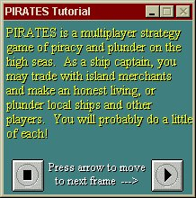
Pirates: Quest for the seas
Notes:
Ici encore, un problème de couleur + 3D qui rend le texte illisible !
his image is taken from the tutorial for Pirates: Quest for the seas. The tutorial ignores the user's display preferences and uses hard-coded colors, the combination of which is reminiscent of that used in older monochromatic computer monitors. We found the combination particularly hurtful on the eyes; the three-dimensional text is an extra bonus to make the text just all that more difficult to read.

Slide 11
QuickTime 4.0 Player
Notes:
Ici le manque de contraste entre les avant plan et arrière plan des symboles gris peut avoir de sérieuses conséquences et rendre difficile finalement le contrôle.
The color scheme dictated by the designers of Apple's QuickTime 4.0 Player could have serious consequences for many users. Because of the lack of contrast between the gray symbols and gray backgrounds of the controls, it can be reasonably expected that certain users will have difficulty locating a control of interest. Older users, and those with even slight visual difficulties will be needlessly disadvantaged when using the software. The designers failed to consider this fact of human vision: the amount of light that passes through the eye of a sixty year-old is only one-third of that passing through the eye of a twenty year-old. The only way to ensure that such users will be able to detect the symbols is to have sufficient contrast between the symbol and its background. Curiously, the contrast is changed after the user has clicked the buttons.

Slide 12
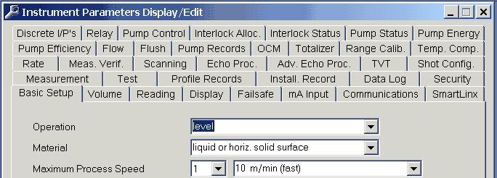
Milltronics' Dolphin Plus
Notes:
Sans commentaire sur l’abus de boîtes de dialogue à onglets.
from Milltronics' Dolphin Plus, a configuration package for industrial level and flow sensors, as a candidate for the Tabbed Dialog Hall of Shame

Slide 13
Microsoft's Visual Source Safe
Notes:
Ce message ne donne pas confiance dans le logiciel ! Et semble plutôt vouloir couvrir les développeurs. En général « Ca risque de ne pas marcher, êtes-vous sûr ? » semble être un moyen de transférer la responsabilité d’un échec du programmeur sur l’utilisateur.
image he received when attempting to add files to a project in Microsoft's Visual Source Safe .
As Rick pointed out, the message does not inspire much confidence in the software, and seems to be not so much a warning as a CYA hedge just in case something goes wrong. The message, "This might not work, are you sure?", seems to be a means of transferring responsibility for the program's failure to the user.

Slide 14
Revision Master
Notes:
Message reçu après avoir essayé de vérifier et d’éditer un fichier dans Revision Master. Un message auto-contradictoire est finalement artistique…
received the following message while trying to check out and edit a file in Revision Master.
In an odd way, such a self-contradicting message is conceptually artistic. There is tension between the two different spellings of "occurred." And an error message stating there's no error has a zen symmetry that's at once perplexing and graceful.

Slide 15
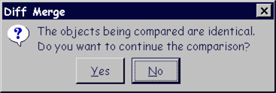
ClearCase de Rational Software
Notes:
Un exemple d’interface stupide: étant donné le résultat, la question paraît irrationnelle.
Kate Adams sent us this example of interface stupidity from ClearCase, a source-code control system from Rational Software. Given the result, the question strikes us as rather irrational.

Slide 17
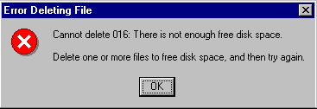
Windows95
Notes:
Message apparu après avoir essayé de détruire un fichier sur un disque presque plein. C’est un des messages les plus stupides.
I came across this message when trying to delete files from a nearly-full hard drive in Windows 95. This has got to be the #1 stupidest error message I have ever seen.
Perhaps this an indication of Microsoft's interpretation of the term "Artificial Intelligence".

Slide 18
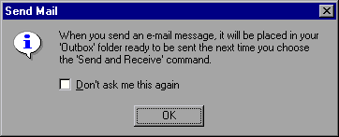
Microsoft's Outlook Express
Notes:
Pouvez-vous répéter la question ? (il n’y a pas de question justement..)
Can you repeat the question ?

Slide 19
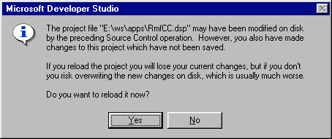
Microsoft Developer Studio
Notes:
Message sans espoir ! Il manque définitivement un bouton: le bouton « je ne sais pas ».
Luke was struck with the "hopelessness" of the message. I've read the message several times, and can only conclude that the dialog box desperately needs another button: I don't know!

Slide 20
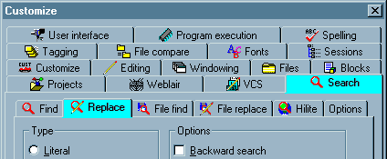
MultiEdit 8.0
Notes:
Voilà un exemple à ne pas suivre si on veut faire une boîte de dialogue à onglets. Le nombre important de tab + les icônes colorés agressent l’œil. En outre, si vous regardez attentivement, vous verrez qu’il y a des tabs imbriqués. En outre deux tabs séparés sont surlignés…
Paul sent us this image of the Options dialog from MultiEdit 8.0. To date, we consider this the definitive example of how not to design a tabbed dialog. The sheer number of tabs, combined with the use of iconic labels and the gratuitous use of graphics on the tabs themselves results in a veritable visual assault. Once your eyes recover from the initial assault, you may be able to spot another problem: the use of nested tabs (note that two separate tabs on the dialog are highlighted).

Slide 21
Mountain Menus
Notes:
Parfois les gens utilisent les onglets pour une raison inhabituelle: ici, ils servent à présenter un menu de boutons de toolbar. Une partie du problème ici est que les toolbars ne reflètent pas les menus qu’elles sont supposées augmenter. Par exemple ici la « View » toobar réplique bien le menu View, mais la toolbar « System » consiste en une partie des items du menu « Configure », et une autre du menu « File ». Pour finir, les distinctions faites dans les onglets des toolbars rend difficile à l’utilisateur les associations entre les toolbars et les menus.
Un des intérêts cependant d’une disposition de toolbar par onglet est qu’elle permet l’arrangement d’un grand nombre d’icônes dans une fenêtre. Mais le côté onglet fait que les toolbars ne sont pas plus accessibles que des menus !
Occasionally, you find people employing tab controls for unusual reasons. This example, taken from Mountain Menus by Lone Wolf Software, shows the use of tab controls to present a menu of toolbar buttons: Part of the problem here is that the toolbars do not necessarily reflect the menus they are intended to augment. While the "View" toolbar, for example, replicates the functions available in the "View" pulldown menu, the "System" toolbar consists of some of the menu items from the "Configure" pulldown menu, and some from the File pulldown menu. At the very least, the distinctions made in the toolbar tabs make it more difficult for the user to develop associations between the toolbars and the menus. One has to wonder however, what possible benefits one can gain by placing toolbars in a tabbed arrangement. Lone Wolf Software claims that the arrangment allows them to present more buttons than can normally fit on a window, and moreover, that they can create bigger buttons without running out of real estate. By placing representations of menu items within tabs however, the developers have simply created a duplicate menus. Toolbar buttons are intended to provide single click access to frequently used menu items. If the toolbar button is within a tab, the user is essentially performing the same action as that provided in the menu. Any possible benefit, if any, provided by this strategy is offset by the difficultes created by inconsistent grouping of items between the tabs and the original menus.

Slide 22
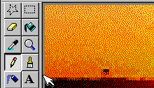
Microsoft Paint
Notes:
On voit ici pourquoi il est important de prévenir l’utilisateur qu’une commande (ou un bouton) est inaccessible.
Microsoft Paint provides a good example of why it is important to make disabled controls appear disabled. To add text to an image in Paint, the user must first use the Text tool to define an area to receive the text. The Text function however, is not available when an image has been zoomed. Most users are unaware of this because the Text tool gives every indication that it is indeed available. In the example illustrated here, the user is trying to add a line of text to a zoomed image of a sunset. Notice that when the Text toolbutton is clicked, it takes on a clicked appearance, but Paint rapidly reverts to the previously selected control. Thus, in attempting to add text to the image, the user inadvertently drew an irregular black line through the image.
After performing such an inadvertent action, most users would assume that they did not click the text tool button. They will try clicking it again, attempt to define the text rectangle, and ... #$%#@~! - there's that darned slash again.
When a tool, or a command is not available, do the user a favor by making it look unavailable.

Slide 23
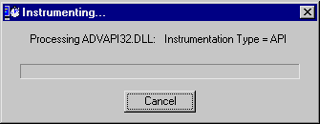
vtune
Notes:
Du mauvais usage des barres de progression.

Slide 24
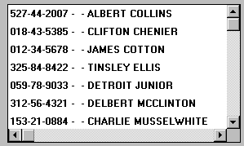
Flexi
Notes:
Pourquoi avoir changer la taille de la fonte (effet loupe), alors que la couleur indiquait déjà la sélection ? Ici, une conséquence inattendue est que le texte n’apparaît plus en entier ☺. Non seulement cet effet loupe est inutile, mais ici, il rend l’information plus difficile à lire.
We found this unusual metaphor in Flexi, an accounting package for medium-sized businesses. We refer to it as the Magnifying Glass Metaphor since the listbox displays a magnified image of the selected item. Our guess is that the designers wanted to increase the likelihood that the user would be able to detect which item has been selected, but we would have thought that the bold blue border would have been sufficient for this purpose. The magnification is not only unnecessary, it makes the information more difficult to read.

Slide 25
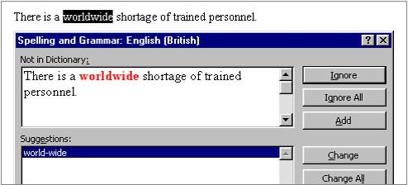
Microsoft's Word 97
Notes:
Ici, un défaut du logiciel plutôt que de l’interface elle-même. Avec le langage English (British), l’outil de vérification de l’orthographe signale une erreur et suggère une correction.
Timothy Tan discovered the following catch-22 in Microsoft's Word 97. When doing a spell check for a document set with the language as "English (British)", the spell check informed him that the word "worldwide" is not in the dictionary and offered to change it to "world-wide".
Tim accepted the application's offer to change the offending word, only to find that Word 97's grammer checker considers the word "world-wide" to be a compound word that would be better written as "worldwide".

Slide 26
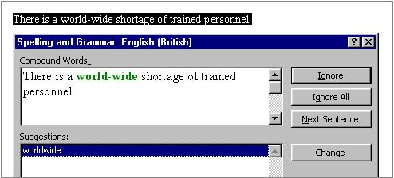
Microsoft's Word 97
Notes:
Mais alors, le vérificateur lui a suggéré de faire le contraire !
La seule manière de résoudre en fait le problème est d’ajouter le mot « worldwide » au dictionnaire, ou de passer à l’anglais américain « English (American) »
Tim discovered that the only way to solve the problem is to add the word "worldwide" to the custom dictionary, or use the "English (American)" dictionary.

Slide 27
Microsoft's Paint
Notes:
La fonction Text de Paint montre un autre exemple de signaux mélangés. Une fois définie la zone de texte, vous pouvez l’agrandir mais pas la diminuer. C’est une première anomalie.
Le curseur est une flèche bi-directionnelle, ce qui prête à confusion, car on ne peut pas aller vers la gauche. De surcroît, ça n’est pas un curseur de texte courant.
The Text function in Microsoft Paint demonstrates another example of mixed signals. Once you have defined the text area, you can enlarge it, but you cannot make it smaller. The cursor symbol, shown as a line with arrows to the right and left, is misleading, since it does not allow you to move to the left. We are at a loss to explain why you cannot make the area smaller, and we are particularly perplexed as to why Microsoft chose to place a "Two-Way Traffic" sign on a one-way street.

Slide 28
MsgBox Mayhem
Notes:
Ici, sélectionner un icône pour un message a pour effet de le faire clignoter. Mais les gens détestent ce type d’agression visuelle. Cela perturbe trop et déconcentre. Il faut vraiment qu’il y ait une bonne raison pour utiliser ce type d’effet, comme par exemple: votre ordinateur va exploser !
Here's one of those interface "features" that most users wish had never been invented. MsgBox Mayhem is a programmer's utility to help design those nasty error messages. Selecting an icon for the message causes the icon to blink - forever. Here's a good rule of thumb to follow: people hate blinking. It is extremely distracting, and should only be used to draw the user's attention to the most severe conditions, such as: "Your computer is on fire".

Slide 29
Installation de Drawing Board LT
Notes:
Au cours de cette installation des centaines de fichiers sont copiés. Le résultat est que l’on a aucune idée du temps qui reste car on ne sait pas combien de fichiers restent à installer. En plus, on se fout du noms de ces fichiers …En outre, la couleur fluo et la vitesse de l’ensemble font qu’on évite plutôt de regarder cette barre qu’autre chose.
This example was taken from the installation of Drawing Board LT, a shareware CAD program. During the course of the installation, several hundred files are copied to your hard drive. Rather than indicate the progress of the entire installation, the authors decided that it was more important to indicate the installation progress of each file.
The end result of this design descision is that the user has absolutely no idea as to the state of the installation. Most of the files are small (less than 10KB), causing the filename to be overwritten with such rapidity that it is impossible to read the name of the file. That's not too much of a problem, since ... well, "Who cares about the names of the files as they are installed?!"
The more shameful aspect of the installation is that the fluorescent green progress meter becomes a completely useless distraction. It flickers with such rapidity that you are forced to turn your eyes away, or better yet, leave the room before installing the software.

Slide 30
Design d’étudiants en première année de Master
extraits de documents pour des projets à réaliser en groupe de 4 à 6 personnes

Slide 31
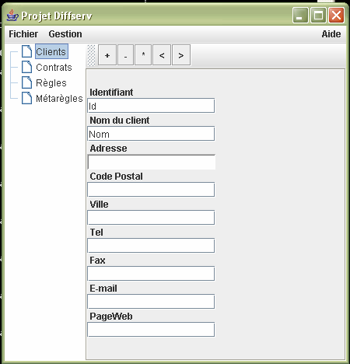
Notes:
La gestion de conflit pour la configuration des
réseaux diffserv

Slide 32
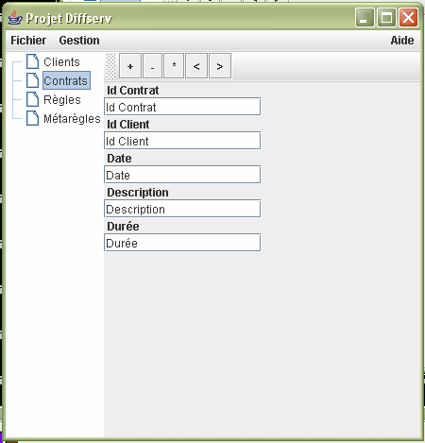

Slide 33
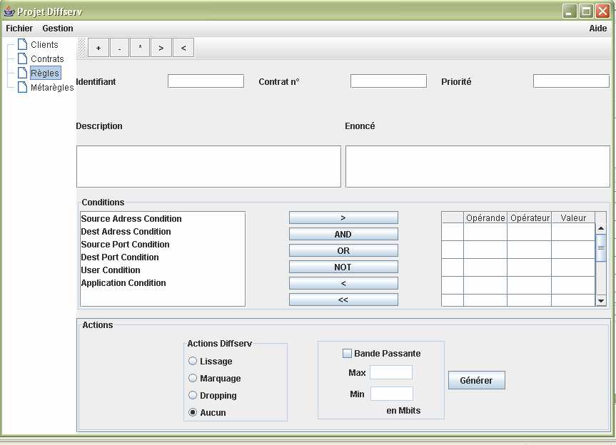

Slide 34
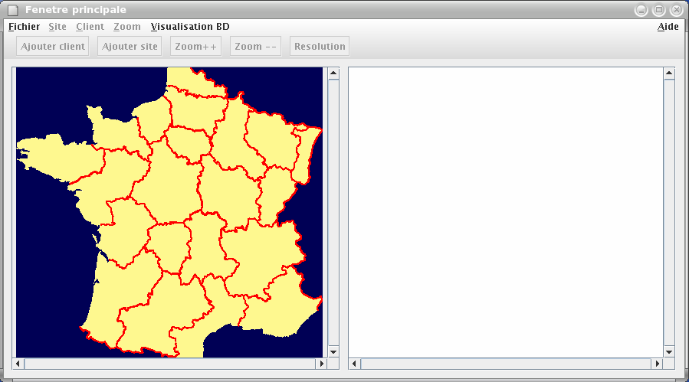
Notes:
CONCEPTION, LOCALISATION ET OPTIMISATION DE LA CHAÎNE
LOGISTIQUE

Slide 35
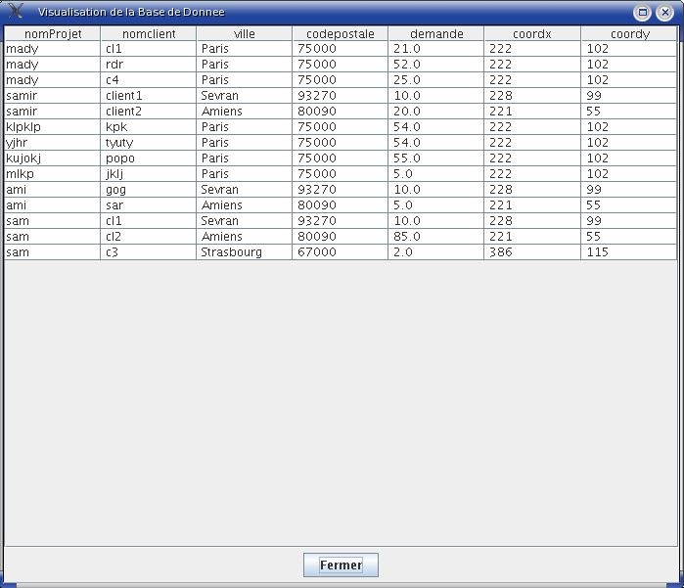

Slide 36
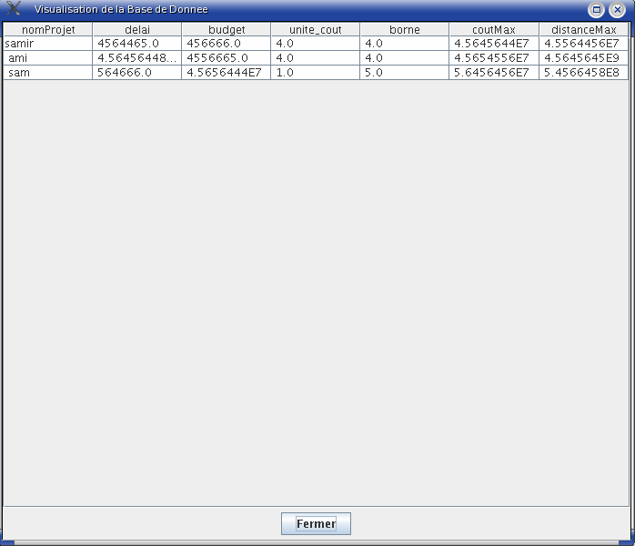

Slide 37
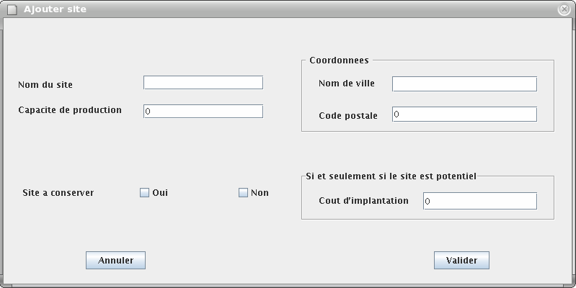

Slide 38
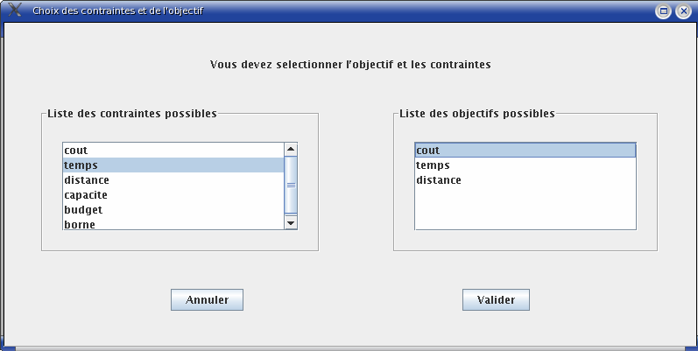

Slide 39
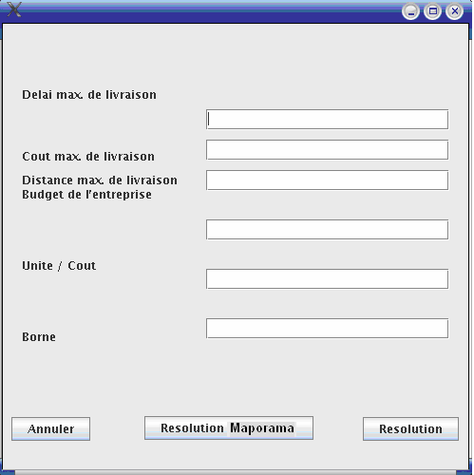

Slide 40
Notes:
Gest artistes

Slide 42
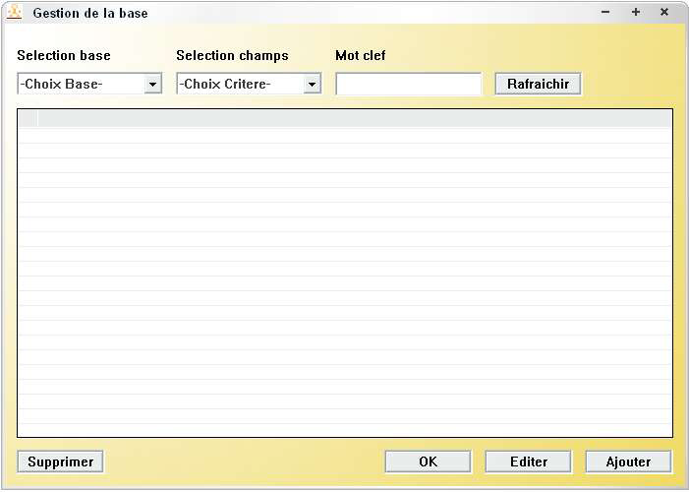

Slide 43
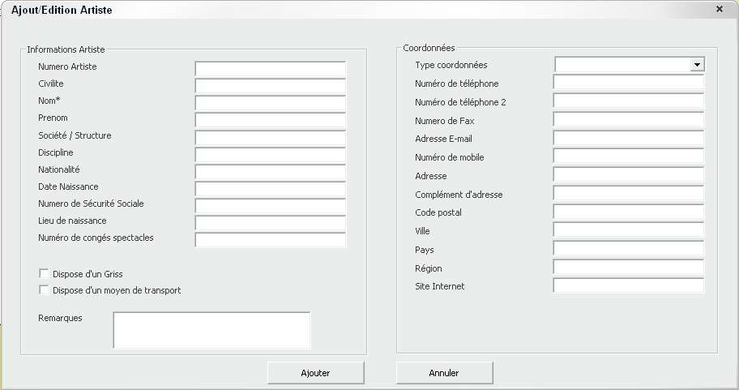

Slide 44
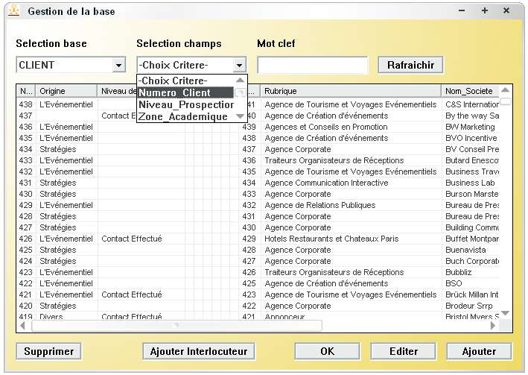

Slide 45
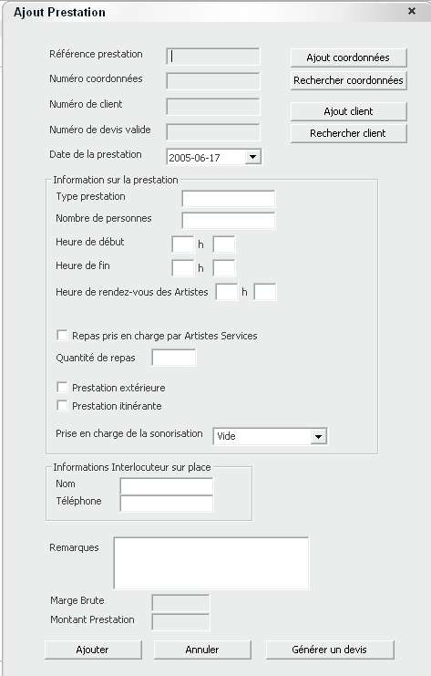

Slide 46
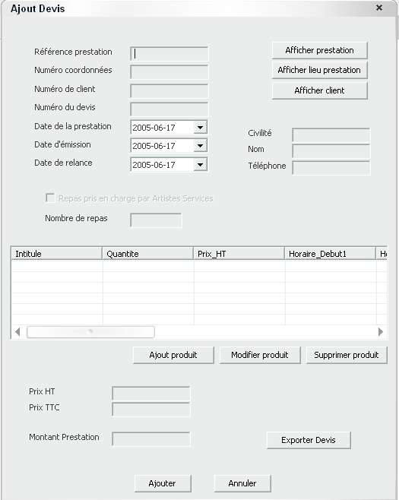

Slide 47
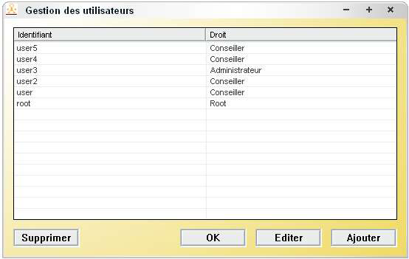

Slide 48
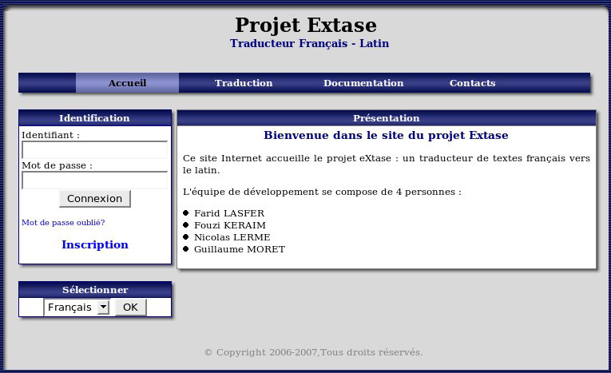
Notes:
eXtase logiciel de traduction franco-latin

Slide 49
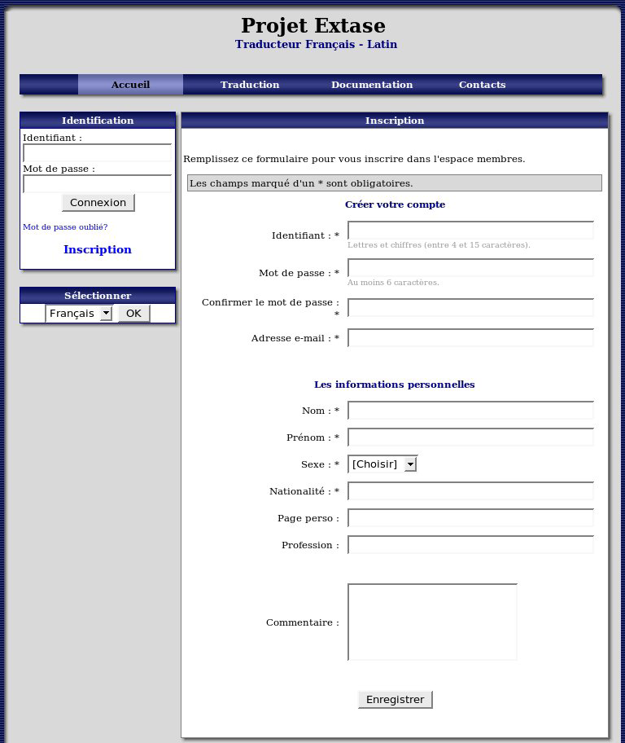

Slide 50
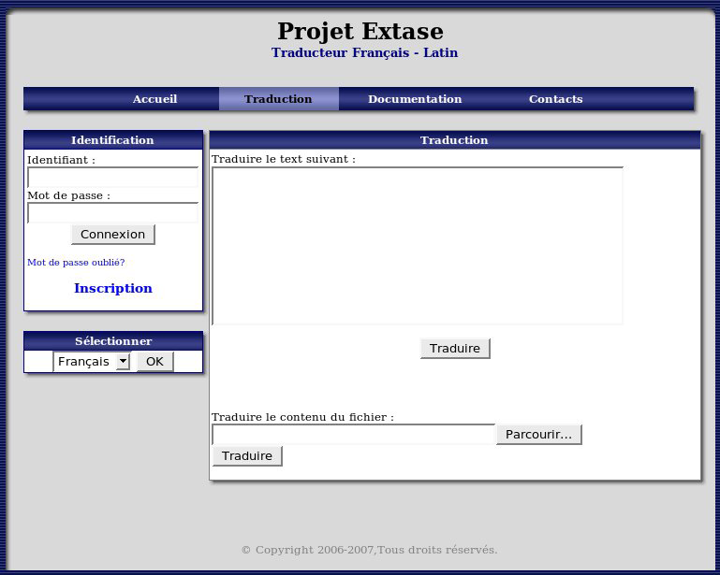

Slide 51
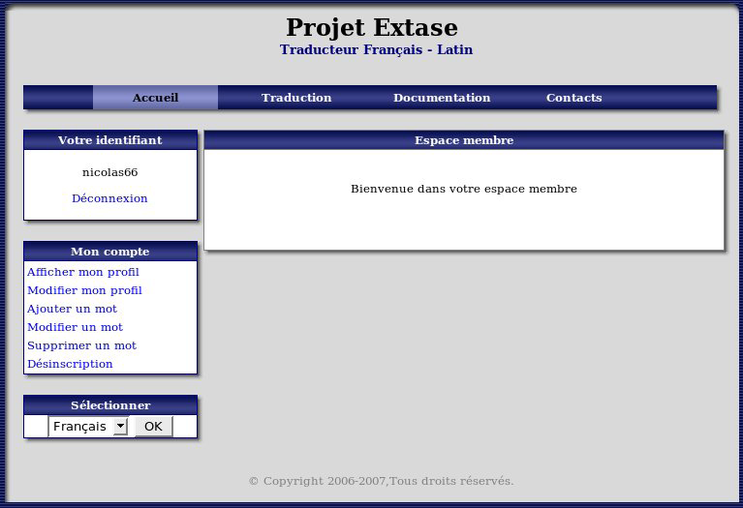

Slide 52
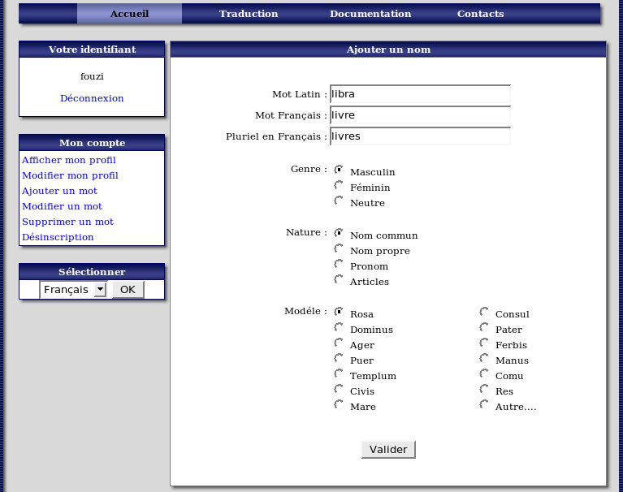

Slide 53
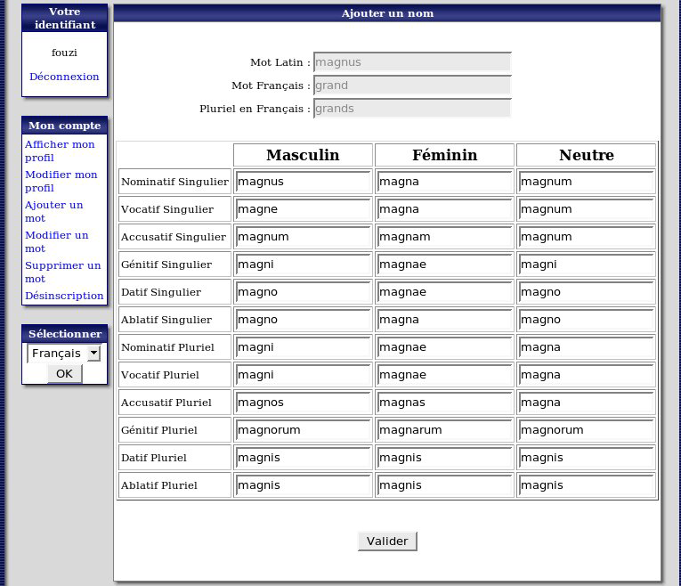

Slide 54
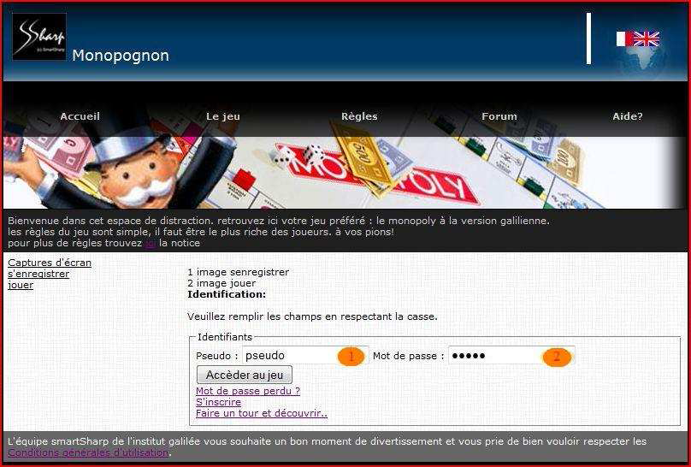
Notes:
Monopoly

Slide 55
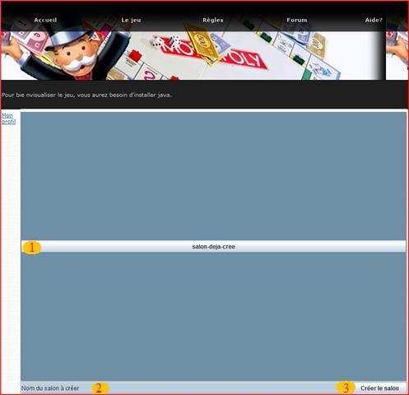

Slide 56
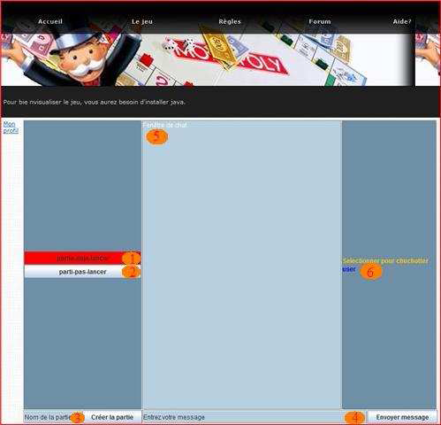

Slide 57
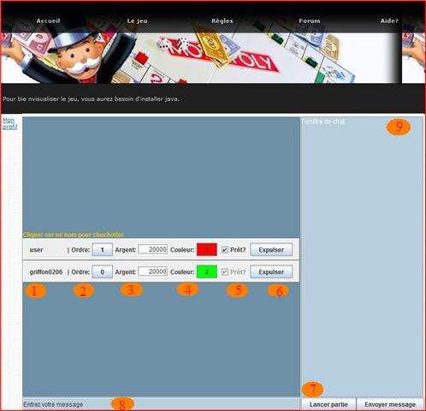

Slide 58
